Slide 1
Facade Pattern
Faisal Pervez
Faraz Ahmed
Abdul Razaq Ali
Umair Farooq

Slide 2
Faisal Pervez

Slide 3
Any fool can write code that a computer can understand. Good programmers write code that humans can understand.
-Martin Fowler

Slide 4
Structural Patterns
Adapter
Bridge
Composite
Decorator
Facade
Flyweight
Proxy
Notes:
Structural patterns are concerned with how classes and objects are composed to form larger structures.
Structural object patterns describe ways to compose objects to realize new functionality. The added flexibility of object composition comes from the ability to change the composition at run-time, which is impossible with static class composition

Slide 5
What is Façade?
The facade pattern is a design pattern that gives a simplified interface to a complex or poorly designed subsystems.
The facade class provides a simple, single-class interface that hides the implementation details of the underlying code.
Facade
Subsystem Classes

Slide 6
Example
The Facade defines a unified, higher level interface to a subsystem that makes it easier to use. Consumers encounter a Facade when ordering from a catalog. The consumer calls one number and speaks with a customer service representative. The customer service representative acts as a Facade, providing an interface to the order fulfillment department, the billing department, and the shipping department.

Slide 7
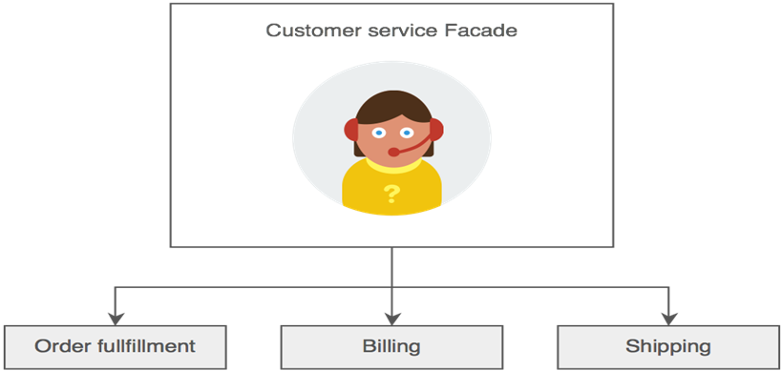

Slide 8
When To Use Facade
Façade is typically used when
wrapping subsystems that are poorly designed but cannot be refactored because the source code is unavailable or the existing interface is widely used.
a simple interface is required to access a complex system;
a system is very complex or difficult to understand.

Slide 9
need an entry point to each level of layered software

Slide 10
Faraz Ahmad

Slide 11
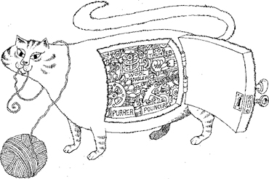
Intent
Encapsulation hides the details of the implementation of an object.
Object-Oriented Analysis and Design, Booch

Slide 12
Intent
Steering System
Brake System
Throttle System
Facade shows how to make a single object represent an entire subsystem.
Notes:
Facade shows how to make a single object represent an entire subsystem. A facade is a representative for a set of objects. The facade carries out its responsibilities by forwarding messages to the objects it represents.

Slide 13
Intent
Provide a unified interface to a set of interfaces in a subsystem. Facade defines a higher-level interface that makes the subsystem easier to use.
Design Patterns: Elements of Reusable Object-Oriented Software, Gamma et al

Slide 14
Motivation
Client
classes
FACADE
Subsystem
classes
Notes:
Structuring a system into subsystems helps reduce complexity. A common design goal is to minimize the communication and dependencies between subsystems. One way to achieve this goal is to introduce a facade object that provides a single, simplified interface to the more general facilities of a subsystem.

Slide 15
Applicability
Provide a simple interface to a subsystem. There are many dependencies between clients and the implementation classes of an abstraction.
Layer your subsystems.
Notes:
Use the facade pattern when:
1.- Simple default view of the subsystem that is good enough for most clients. Only clients needing more customizability will need to look beyond the facade.
2.- Introduce a facade to decouple the subsystem from clients and other subsystems, thereby promoting subsystem independence and portability.
3.- Use a facade to define an entry point to each subsystem level.

Slide 16
Participants
Facade
  Delegate requests to appropriate subsystem objects.
Subsystem classes
  Implement subsystem functionality.
  Handle work assigned by the facade.

Slide 17
Consequences
Shields clients from subsystem components.
Promotes weak coupling between the subsystems and its clients.
It’s does not prevent applications from using subsystem classes if they need to.
Notes:
The Facade pattern offers the following benefits:
1.- Reduce the number of objects that clients deal with and make the subsystem easier to use.
2.- Weak coupling lets you vary the components of the subsystem without affecting its clients. Facades help layer a system and the dependencies between objects. They can eliminate complex or circular dependencies. This can be an important consequence when the client and the subsystem are implemented independently.
In large software systems reducing compilation dependencies with facades can limit the recompilation needed for a small change in an important subsystem
3.-

Slide 18
Adapter VS Façade
Adapter
Facade
You have an existing client (application) that uses an old interface to an existing support package.
You are given a new interface to a new support package.
You need to produce an adapter so that:
  The client can use the new interface instead of the old one (without changing the client)
A facade provides a single simplified interface to a larger part of the system (a subsystem)
The facade makes this subsystem more readable and easier to understand
Having facades minimizes communication and dependencies between subsystems

Slide 19
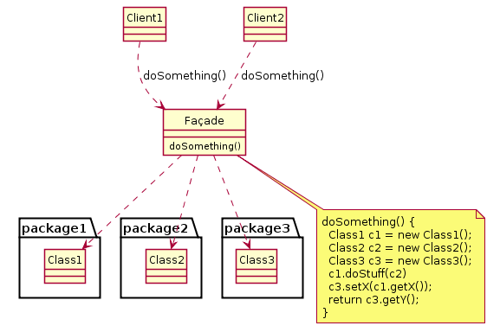
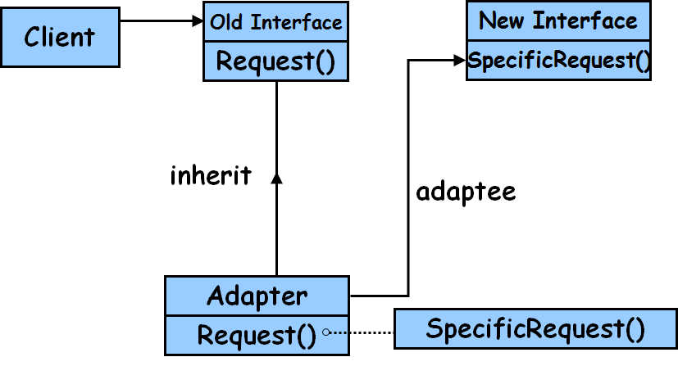
Adapter VS Façade
Adapter
Facade

Slide 20
Abdul Razaq Ali

Slide 21
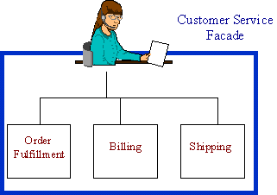
Phone Order Example

Slide 22
Phone Order Example
The Facade defines a unified, higher level interface to a subsystem, that makes it easier to use. Consumers encounter a Facade when ordering from a catalog. The consumer calls one number and speaks with a customer service representative. The customer service representative acts as a Facade, providing an interface to the order fulfillment department, the billing department, and the shipping department.

Slide 23
Example of Compiler
Consider for example a programming environment that gives application access to its compiler subsystem. This subsystem contains classes such as Scanner, Parser, ProgramNode, ByteCodeStream, and ProgramNodeBuilder that implements te Compiler. Some Specialized applications might need to access these classes directly.
But most clients of a compiler generally don’t care about details like parsing and byte code generation; they merely want to complier subsystem only complicate their task.

Slide 24
Example of Compiler
Facade
Compiler class in the above can act as a façade, which will provide higher-level interface that can shield clients form these classes, the compiler subsystem also includes a Compiler class. This class defines a unified interface to the compiler’s functionality.
It offers client a single, simple interface to the compiler subsystem. It glues together the classes that implement compiler functionality without hiding them completely.

Slide 25
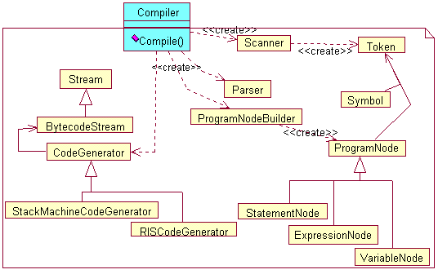
Example of Compiler

Slide 26
Questions & Answers

